Slide 1
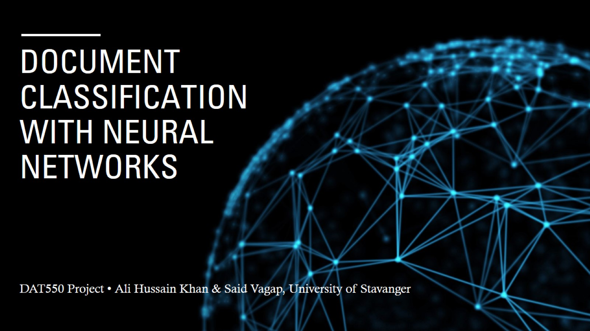
Document Classification with Neural Networks

Slide 2
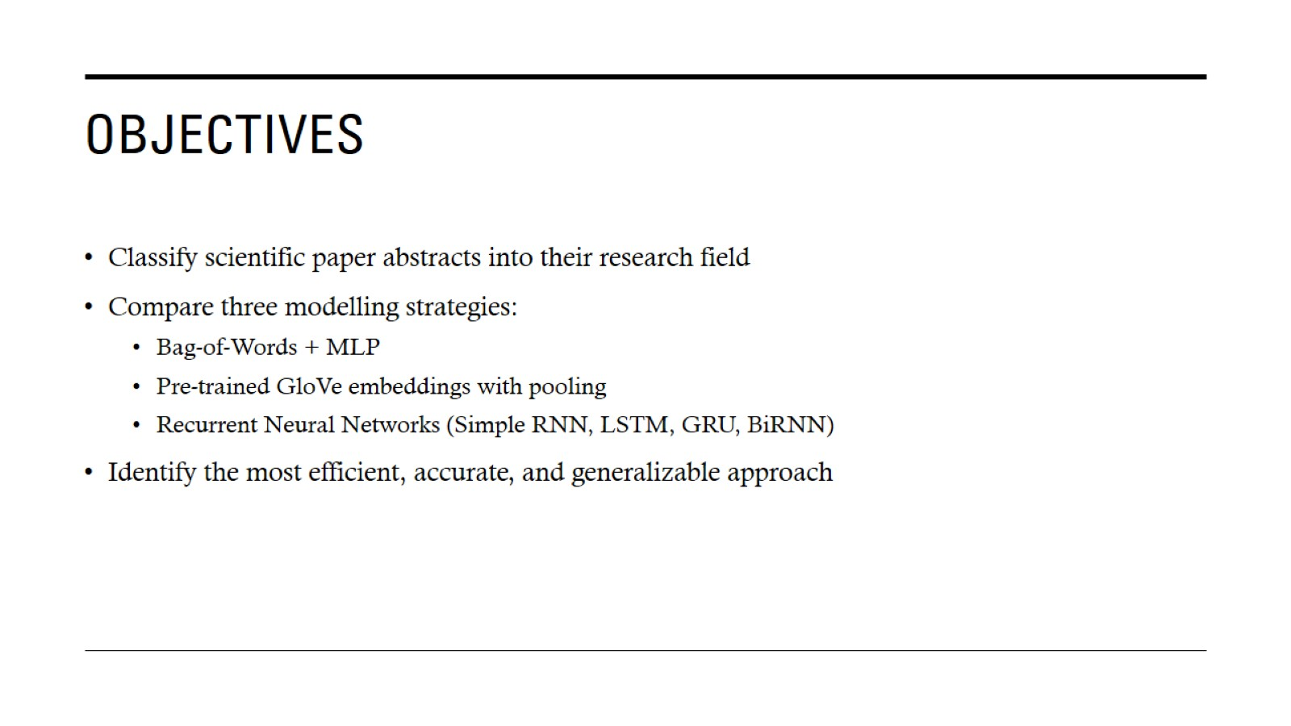
Objectives

Slide 3
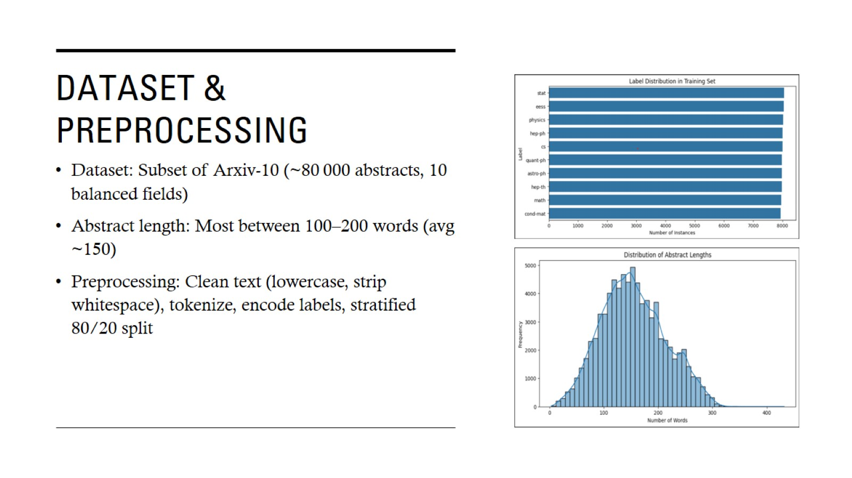
Dataset & Preprocessing

Slide 4
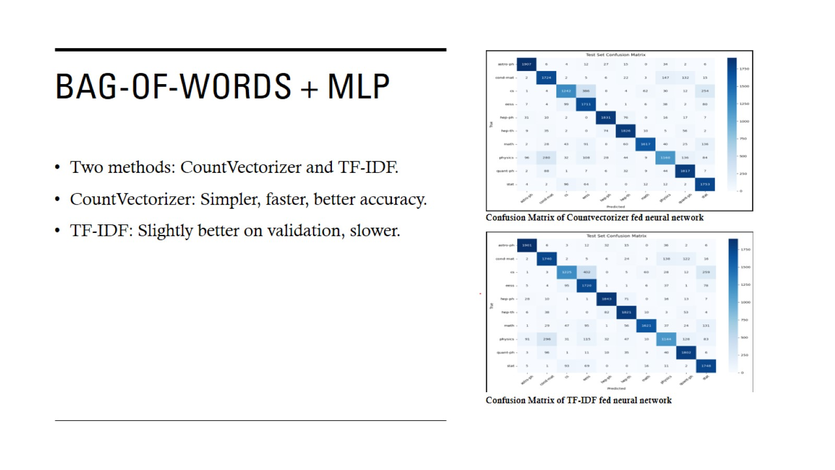
Bag-of-Words + MLP

Slide 5
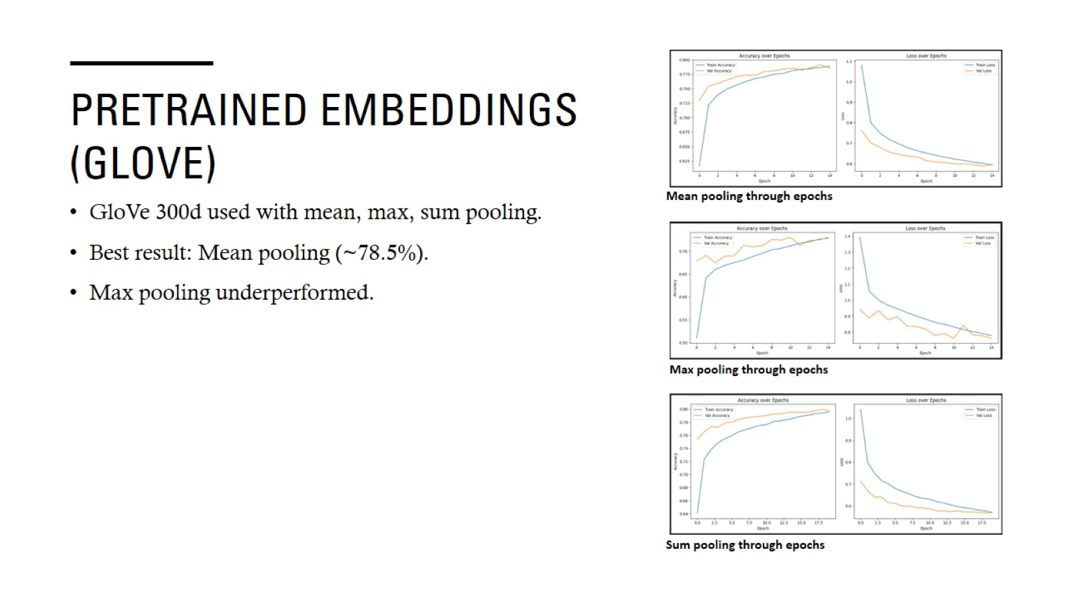
Pretrained Embeddings (GloVe)

Slide 6
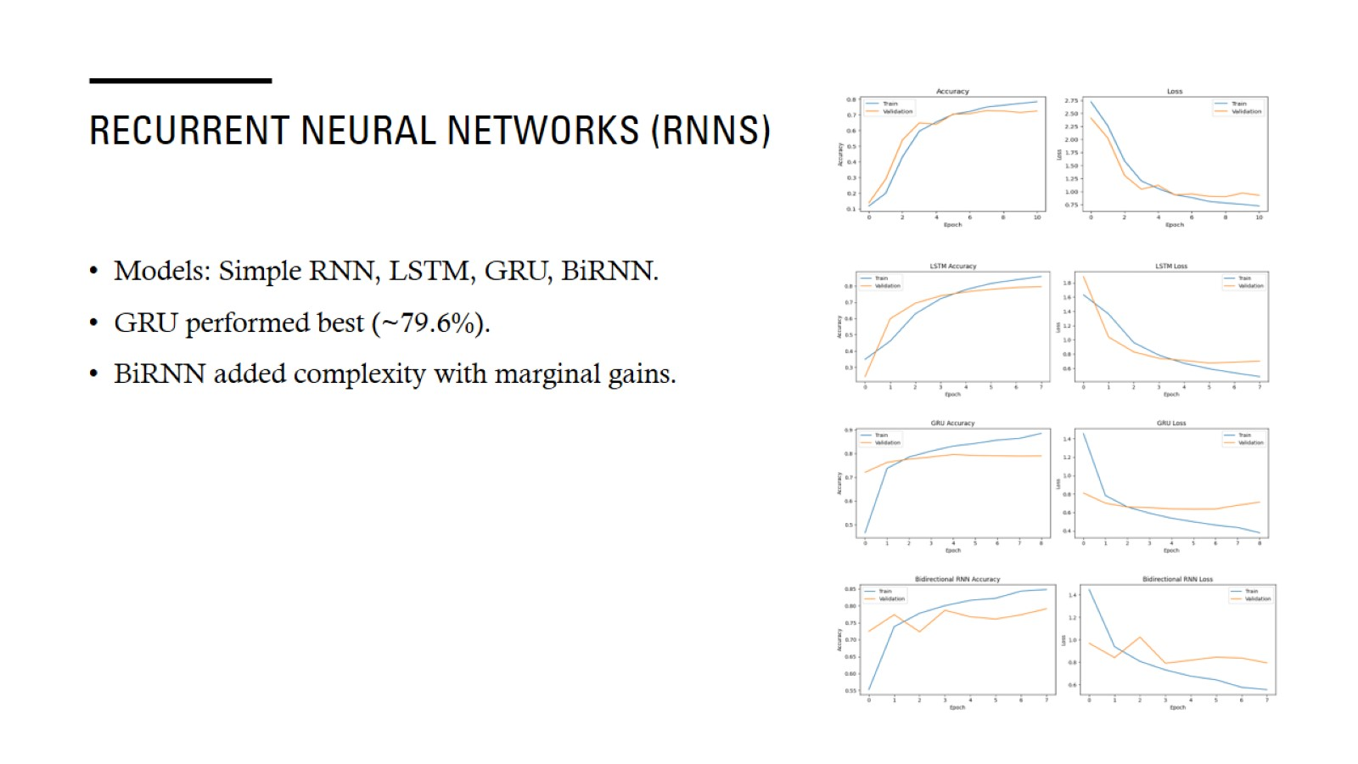
Recurrent Neural Networks (RNNs)

Slide 7
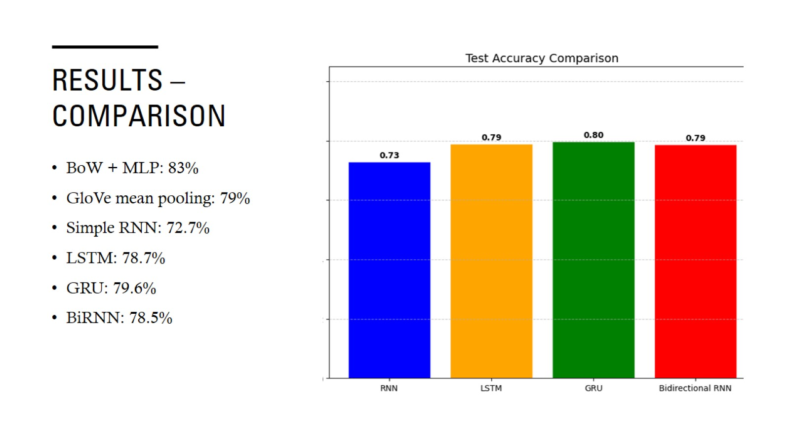
Results – Comparison

Slide 8
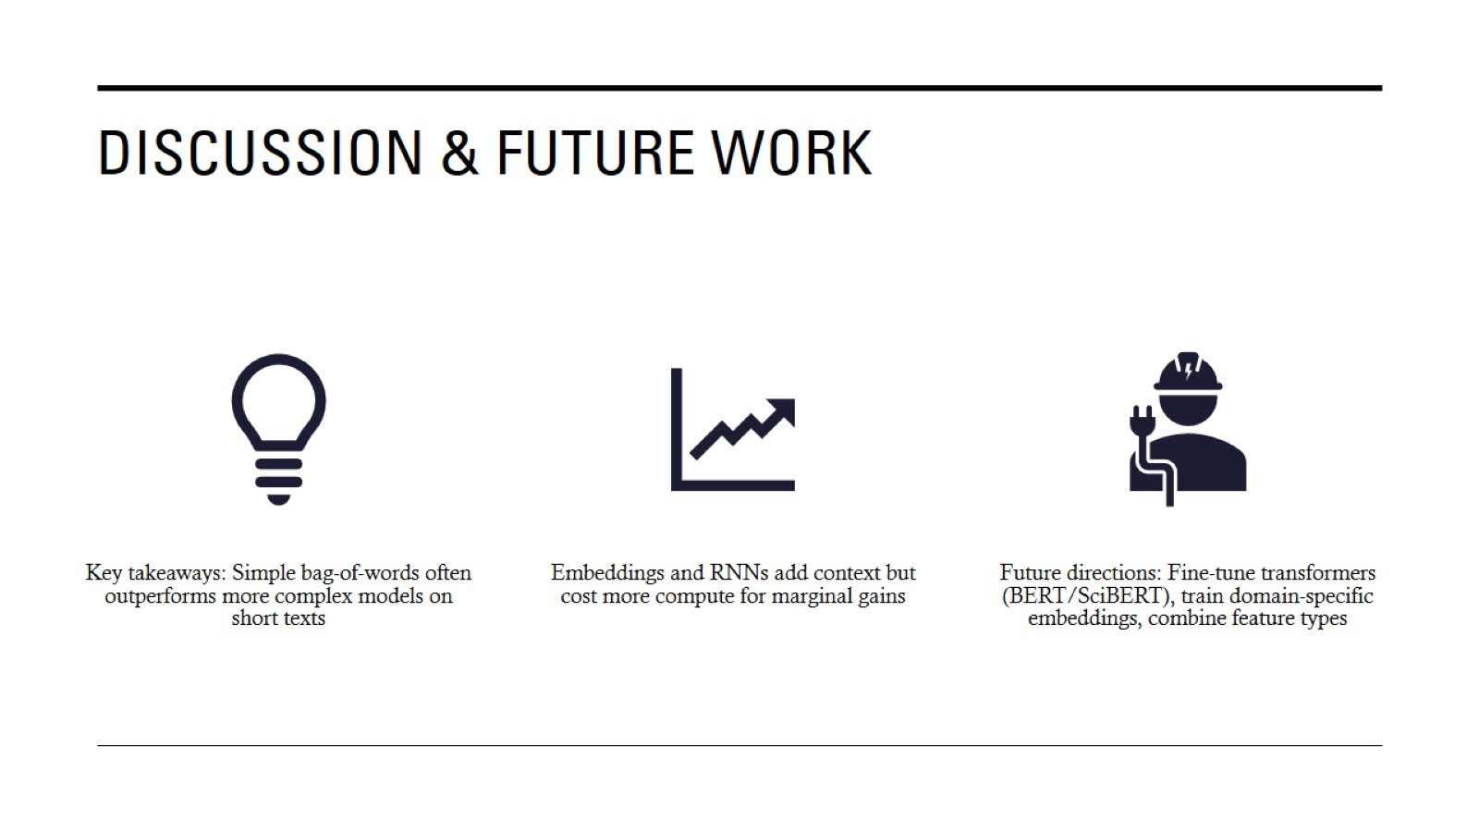
Discussion & Future Work

